Slide 1
Time Value of Money

Slide 2
Introduction
Meaning
Simple interest vs. compound interest rate.
Seven interest formulas.

Slide 3
Important notations for the interest formulas unit
P=Principal amount/present worth amount/present value amount
F=Maturity amount/future worth amount/future value amount
i=Interest rate/Rate of interest (Compound interest rate)
A= Annual equivalent amount/Equal cash flow in each interest period
n= Number of interest periods (It may be in terms years, months, quarters, weeks etc.)

Slide 4
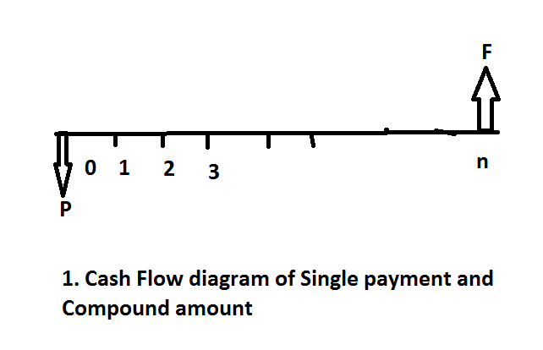
1. Single-Payment compound Amount
i%

Slide 5
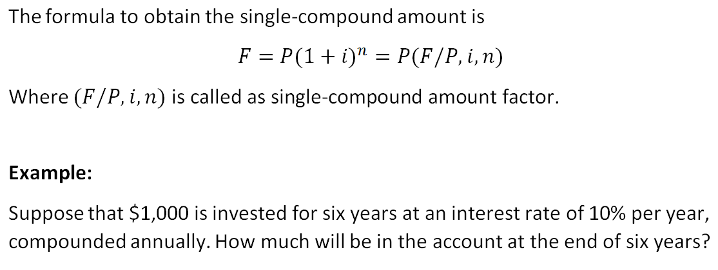

Slide 6
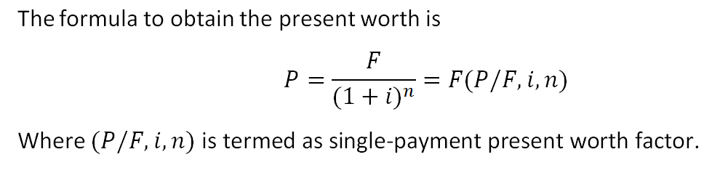
2. Single-Payment Present Worth Amount

Slide 7
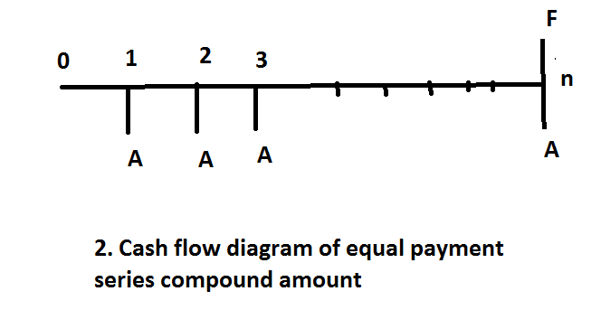
3. Equal-Payment Series Compound Amount

Slide 8
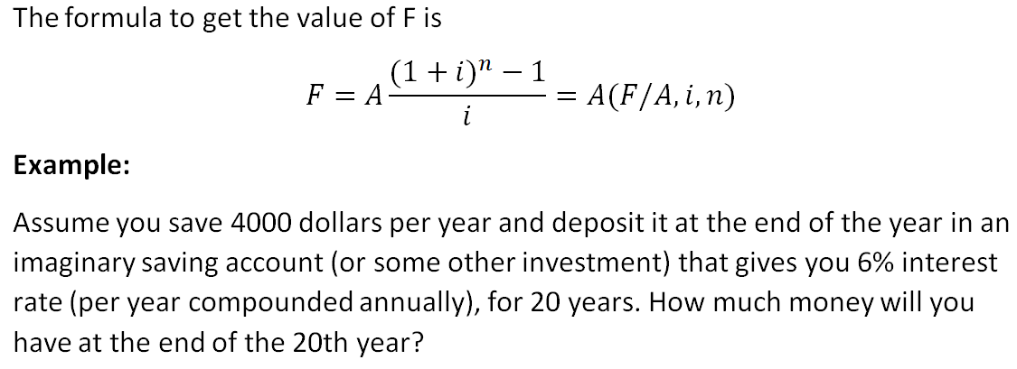
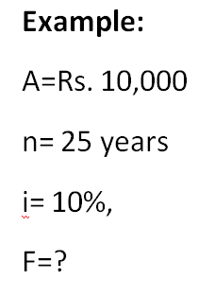

Slide 9
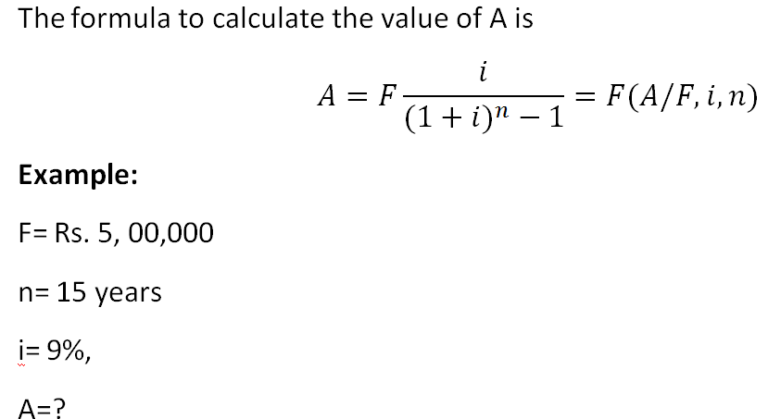
4. Equal-Payment Series Sinking Fund

Slide 10
5. Equal Payment Series Present Worth Amount
The objective of this mode of investment is to find the present worth of an equal payment made at the end of every interest period for ‘n’ interest periods at an interest rate of “i” compounded at the end of every interest period.

Slide 11

Formula:
Example: A company wants to set up a reserve which will help the company to have an annual equivalent amount of Rs.10,00,000 for the next 20 years towards its employees welfare measures. The reserve is assumed to grow at the rate of 15% annually. Find the single payment that must be made now as the reserve amount?

Slide 12
Solution:
A=10,00,000
i=15%
N=20 years
P=?

Slide 13

6. Equal Payment Series Capital Recovery Amount
The objective of this mode of investment is to find the annual equivalent amount (A) which is to be recovered at the end of every interest period for n interest periods for a loan (P) which is sanctioned now at an interest rate of i compounded at the end of every interest period.

Slide 14
Example:
A bank gives a loan to a company to purchase an equipment worth Rs. 10,00,000 at an interest rate of 12% compounded annually. This amount should be repaid in 15 yearly equal instalments. Find the instalment amount that the company has to pay to the bank.
Solution:
P=Rs. 10,00,000
i=12%
n=15 years, A=?

Slide 15
7. Uniform Gradient Series Annual Equivalent Amount
The objective of this mode of investment is to find the annual equivalent amount of a series with an amount A1 at the end of the first year and with an equal increment (G) at the end of each of the following (n-1) years with an interest rate i compounded annually.

Slide 16
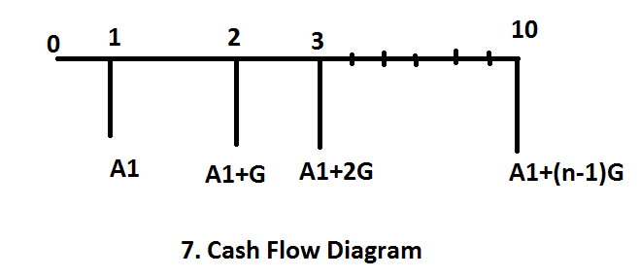

Formula:

Slide 17
Example:
A person is planning for his retired life. He has 10 more years of service. He would like to deposit 20% of his salary, which is Rs. 4,000, at the end of the first year, and thereafter he wishes to deposit the amount with an equal increase of Rs. 500 for the next 9 years with an interest rate of 15%. Find the total amount (F) at the end of the 10th year of the above series.

Slide 18
Solution
A1=4,000
G=500
i=15%
n=10 years
A=? & F=?
Steps:
Calculate ‘A’
Calculate ‘F’ by using value of ‘A’
(Hints: F=A(F/A,i,n)
Ans: A=6,214.06; F= Rs.1,26,168.524

